Slide 1


Intermediate Python
Exception Fundamentals

Slide 2
What Are Exceptions?
Exceptions are Python’s way of signaling that something unexpected or invalid happened during execution.
Exceptions interrupt the normal flow of a program
They represent runtime errors (not syntax errors)
Examples: ValueError, TypeError, ZeroDivisionError
Unhandled exceptions stop the program
Handling exceptions makes programs more robust
Notes:
Emphasize that exceptions are signals, not bugs by default. Python is telling us something went wrong at runtime.

Slide 3
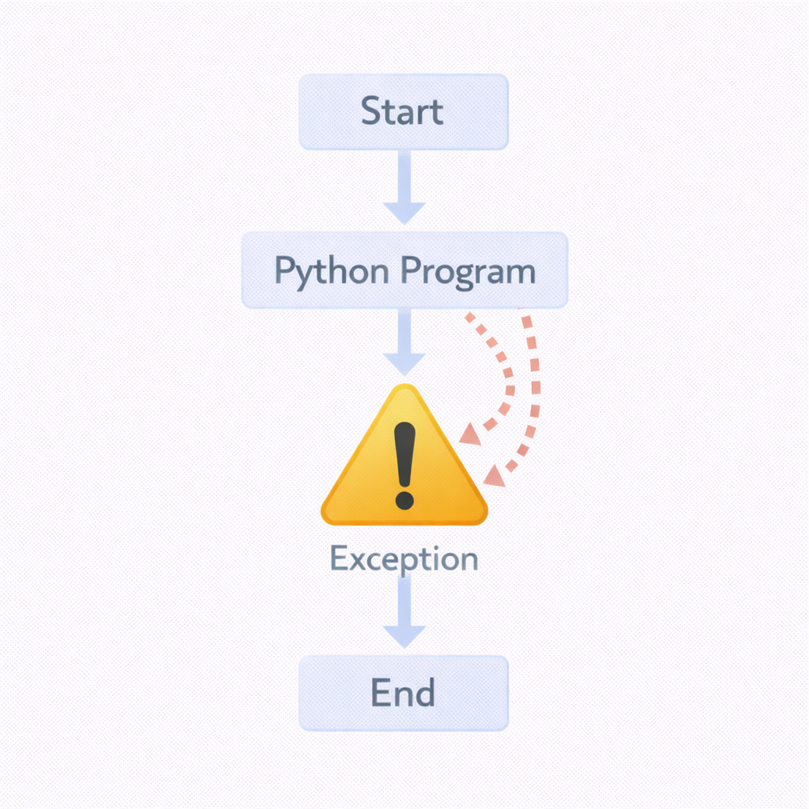
Code Example
x = int("abc") # ValueError
print("This will not run")

Slide 4
Exception Flow (How Errors Propagate)
When an exception occurs, Python looks for a handler by unwinding the call stack.
Exception starts where the error happens
Python searches upward through function calls
First matching except handles it
If no handler is found → program crashes
This process is called stack unwinding
Notes:
Explain that exceptions don’t “jump randomly” — they follow the call stack in a very predictable way.

Slide 5
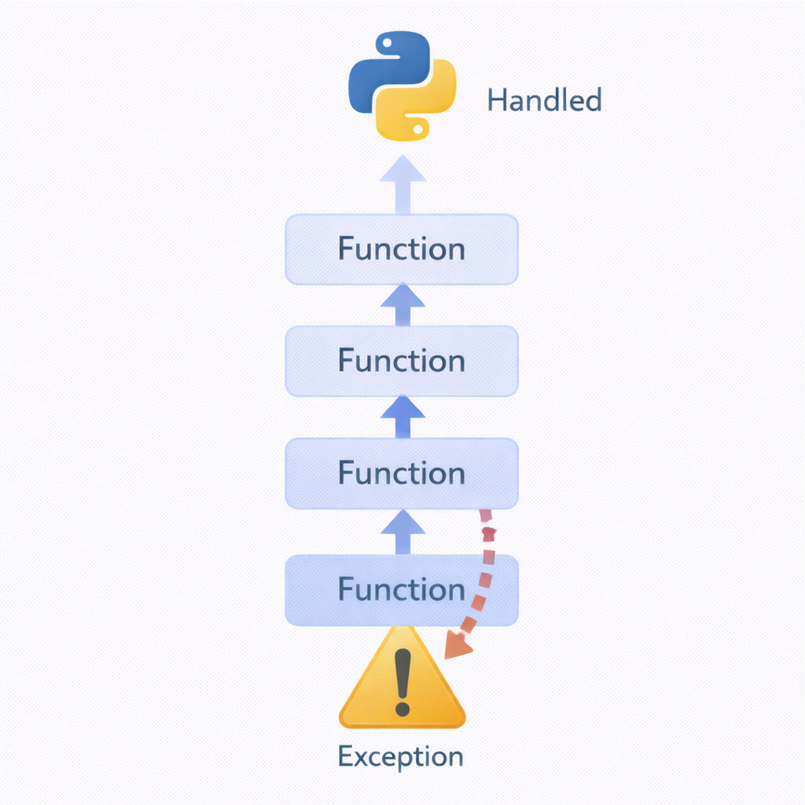
Code Example
def level2():
return 10 / 0
def level1():
level2()
level1()

Slide 6
try / except: Handling Errors
try and except let you handle errors gracefully instead of crashing.
Code that may fail goes inside try
Error-handling logic goes inside except
You can catch specific exception types
Prevents program termination
Enables controlled recovery
Notes:
Stress that catching specific exceptions is better than catching everything.

Slide 7
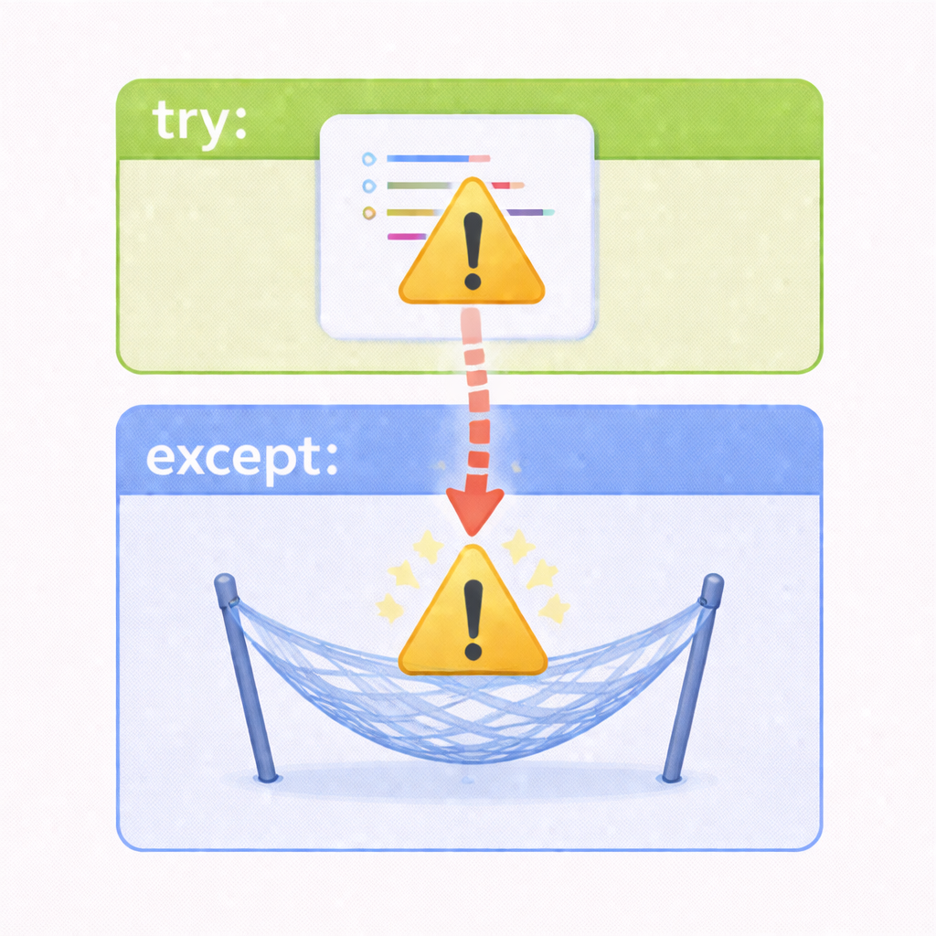
Code Example
try:
x = int("abc")
except ValueError:
print("Invalid number input")

Slide 8
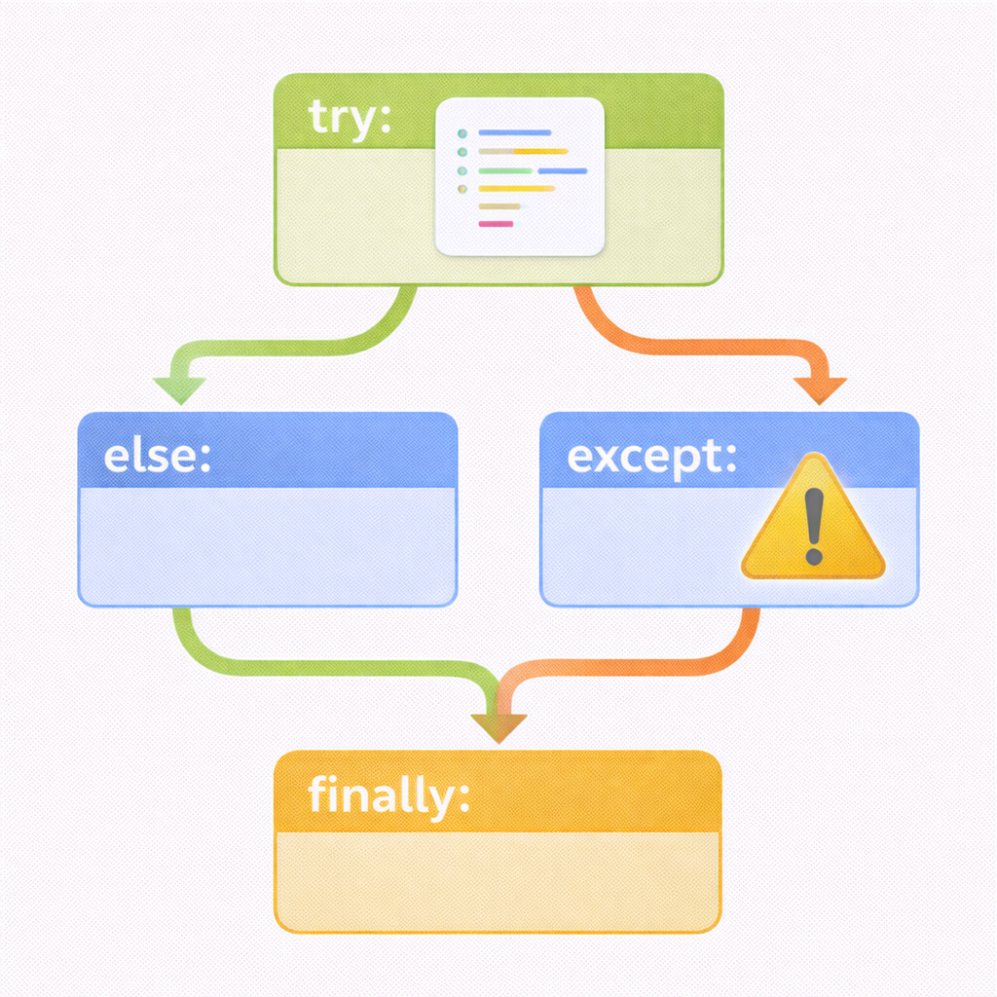
else and finally Blocks
else runs when no exception occurs, and finally always runs.
else executes only if try succeeds
finally runs no matter what (error or not)
Useful for cleanup (files, connections)
Improves clarity of success vs failure paths
Makes intent explicit
Notes:
Relate finally to real-life cleanup: “no matter what happens, close the door”.

Slide 9
Code Example
try:
x = int("10")
except ValueError:
print("Conversion failed")
else:
print("Conversion succeeded:", x)
finally:
print("Done")

Slide 10
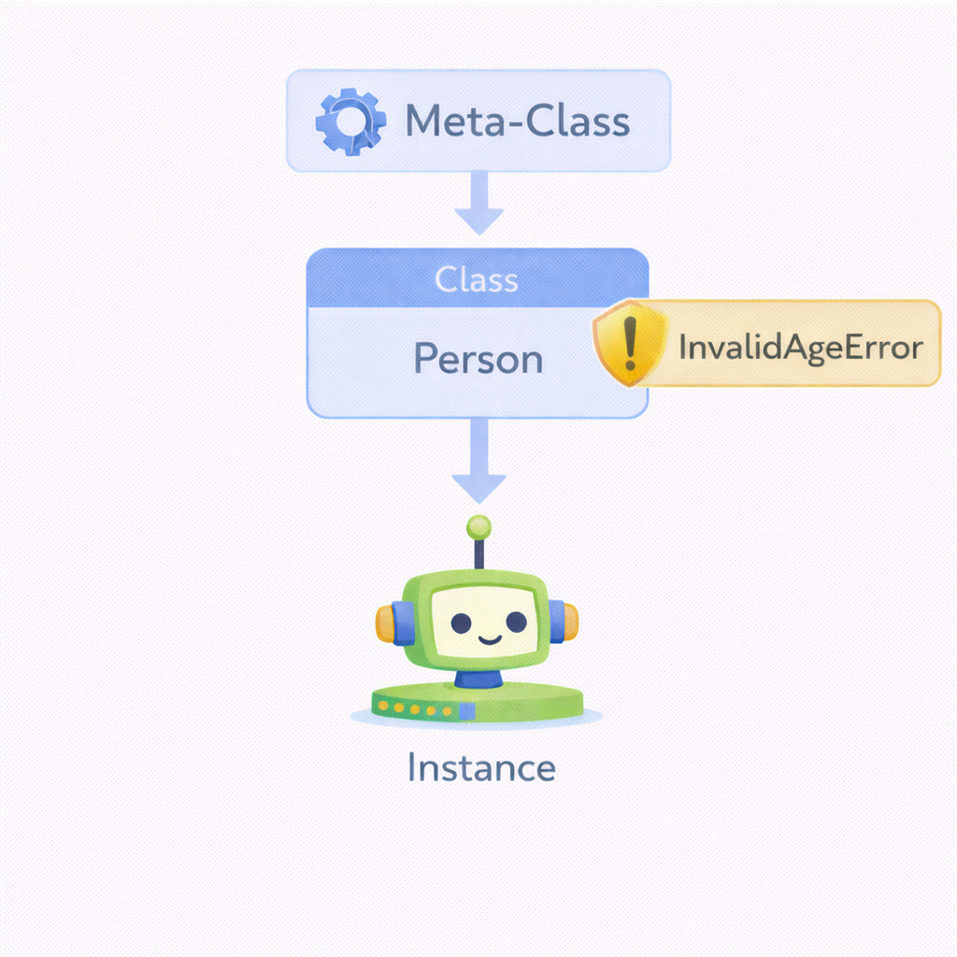
Creating Custom Exceptions
Custom exceptions make errors more meaningful and domain-specific.
Built by subclassing Exception
Improve readability and intent
Useful for business or domain rules
Easier to catch specific failures
Encourage clean error design
Notes:
Highlight that custom exceptions are about communication, not complexity.

Slide 11
Code Example
class InvalidAgeError(Exception):
pass
def set_age(age):
if age < 0:
raise InvalidAgeError("Age cannot be negative")

Slide 12

Raising Exceptions Intentionally
You can raise exceptions yourself to enforce rules and protect state.
Use raise to signal invalid conditions
Prevents silent failures
Makes contracts explicit
Often paired with validation
Keeps bugs close to their source
Notes:
Explain that raising early is better than letting bad data flow through the system.

Slide 13
Code Example
def withdraw(balance, amount):
if amount > balance:
raise ValueError("Insufficient funds")

Slide 14
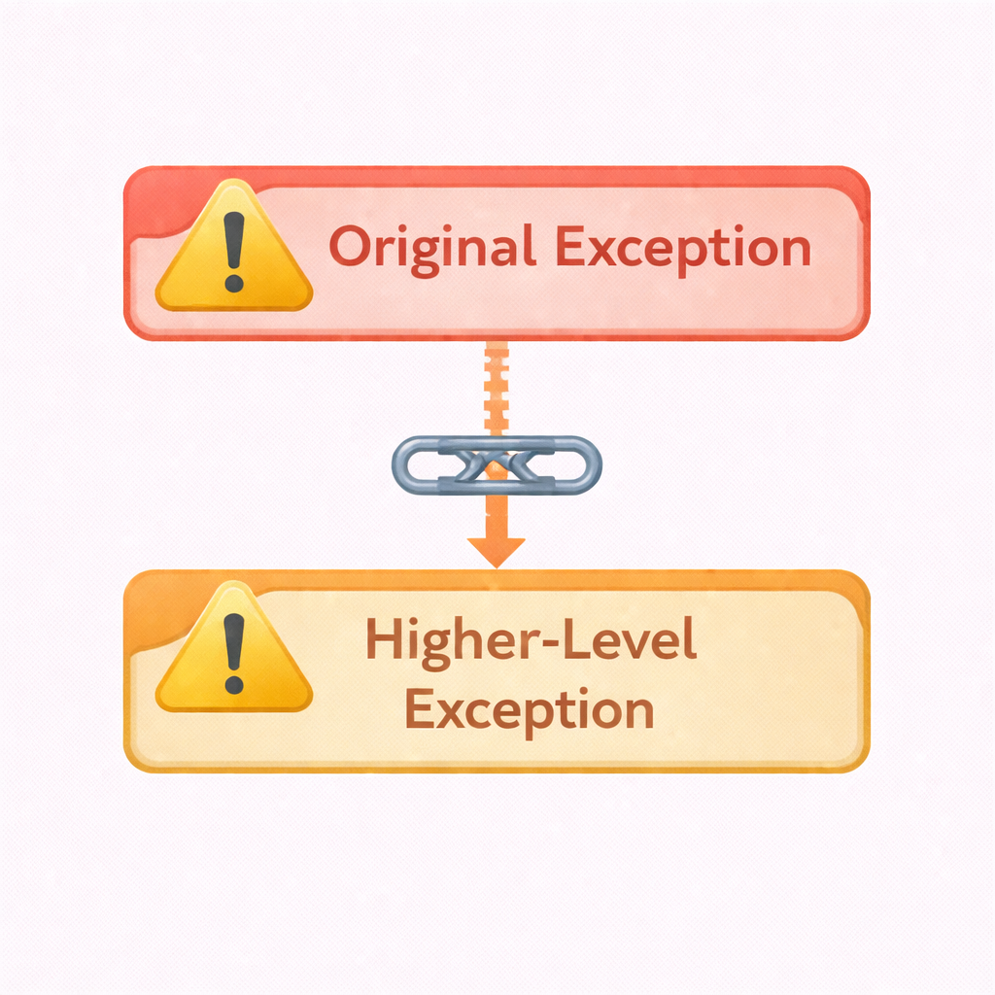
Exception Chaining (Root Cause Preservation)
Exception chaining keeps the original error while adding context.
Use raise ... from ...
Preserves original traceback
Adds higher-level meaning
Essential for debugging complex systems
Common in layered architectures
Notes:
Explain this as “don’t hide the real problem—wrap it with context”.

Slide 15
Code example
try:
int("abc")
except ValueError as e:
raise RuntimeError("Failed to parse user input") from e

Slide 16
Key Takeaways
Exception handling is about control, clarity, and safety.
Exceptions control abnormal execution flow
try/except prevents crashes
else/finally clarify intent and cleanup
Custom exceptions improve design
Chaining preserves debugging context
Notes:
Reinforce that good exception handling is a design skill, not just syntax.

